Slide 1
Week 3
Introduction to neural networks
and deep learning

Slide 2
Topics you have covered in week 3 videos
Intro to babysitting and learning process
Data preprocessing
Data augmentation
Weight initialization
Regularization
Batch normalization
Dropout
Hands on demo

Slide 3
Session agenda
Data preprocessing
Data augmentation
Weight initialization
Regularization
Case study
Questions

Slide 4
Data preprocessing

Slide 5
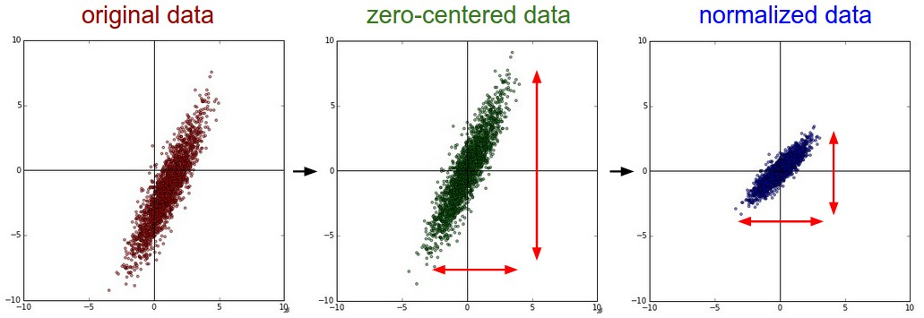
Data preprocessing
Mean subtract
Divide by standard deviation

Slide 6
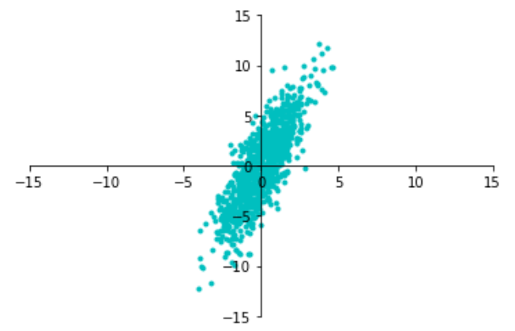
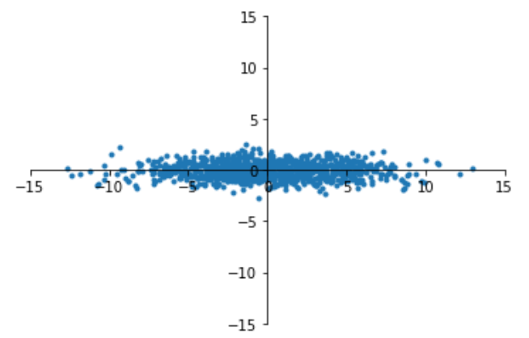
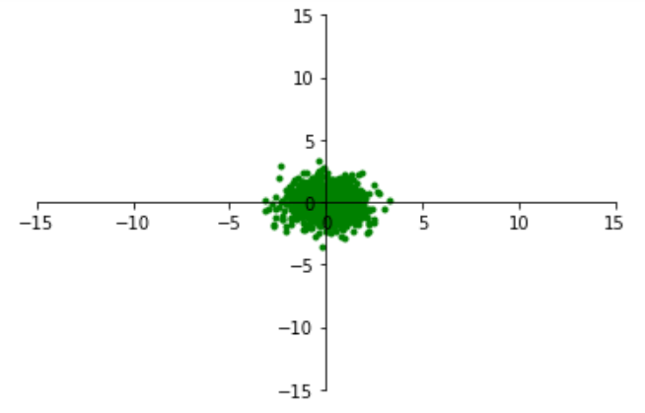
Data preprocessing
Original Data
Decorrelated Data
Whitened Data
data has diagonal covariance matrix
covariance matrix is the identity matrix

Slide 7
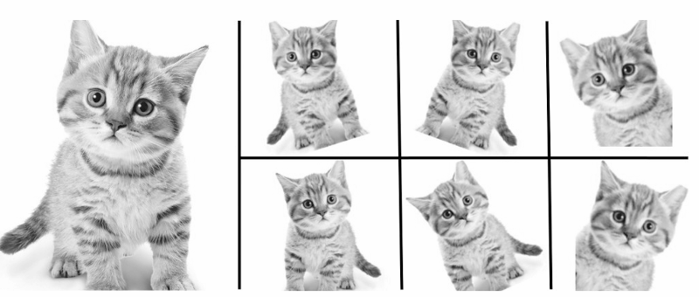
Data augmentation
Image source: medium

Slide 8
Why we should do data augmentation?
We may not have a big dataset, so create more data.
It helps in regularizing the network.

Slide 9



Data augmentation pipeline
Load image and label
“Dog”
Compute
loss
CNN
Transform image

Slide 10
Data augmentation techniques
Horizontal flips
Rotation
Crop/scale
Color jitter
Other creative techniques
Random mix/combinations of :
translation (what about a pure ConvNet?)
Rotation
Stretching
Shearing
lens distortions, … (go crazy)

Slide 11
Data augmentation
Image augmentation artificially creates training images through different ways of processing or combination of multiple processing, such as random rotation, shifts, shear and flips
Very easy to implement, give good results especially on small datasets
Easily fits into framework of noise / marginalization

Slide 12
Weight initialization

Slide 13
Why initialize weights?
The aim of weight initialization is to prevent layer activation outputs from exploding or vanishing during the course of a forward pass through a deep neural network. If either occurs, loss gradients will either be too large or too small to flow backwards beneficially, and the network will take longer to converge, if it is even able to do so at all.
Text source: medium

Slide 14


What happens when W=0 init is used?
Input Layer
Hidden Layer
Output Layer

Slide 15
Initialization techniques
Zero initialization
Random initialization
Xavier initialization
He initialization
Kaiming initialization
And many more

Slide 16
Regularization

Slide 17
Batch normalization
Improves gradient flow through the network
Allows higher learning rates
Reduces the strong dependence on initialization
Acts as a form of regularization in a funny way, and slightly reduces the need for dropout, maybe

Slide 18
Dropout
Dropout is a regularization method that approximates training a large number of neural networks with different architectures in parallel.
During training, some number of layer outputs are randomly ignored or “dropped out.” This has the effect of making the layer look-like and be treated-like a layer with a different number of nodes and connectivity to the prior layer. In effect, each update to a layer during training is performed with a different “view” of the configured layer.

Slide 19
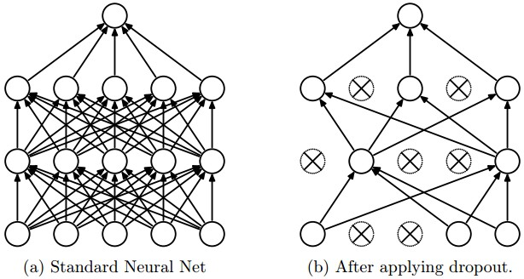
Dropout

Slide 20
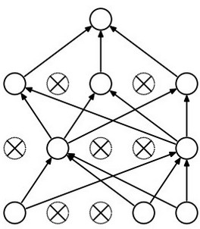
Dropout: how it works?
Forces the network to have a redundant representation.
has an ear
X
has a tail
is furry
X
cat
score
has claws
X
mischievous
look

Slide 21
Dropout
Another interpretation:
Dropout is training a large ensemble of models (that share parameters).
Each binary mask is one model, gets trained on only ~one batch.

Slide 22
Summary

Slide 23
We have learned about...
Data preprocessing
Data augmentation
Weight initialization
Batch normalization
Dropout

Slide 24


Slide 25
Thank you! :)
Questions are always welcome

